Slide 1
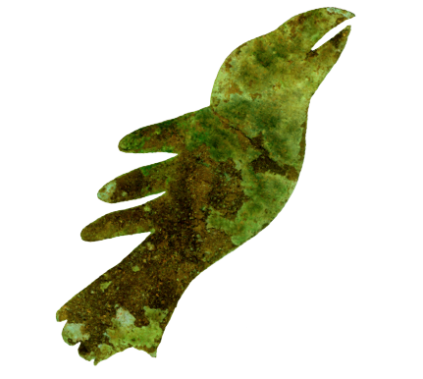
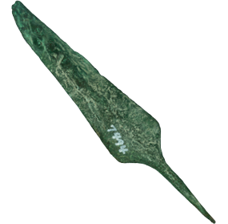
THE HISTORY
OF
PREHISTORIC COPPER
IN
MICHIGAN
By
Don Spohn
GREAT LAKES COPPER RESEARCH

Slide 2
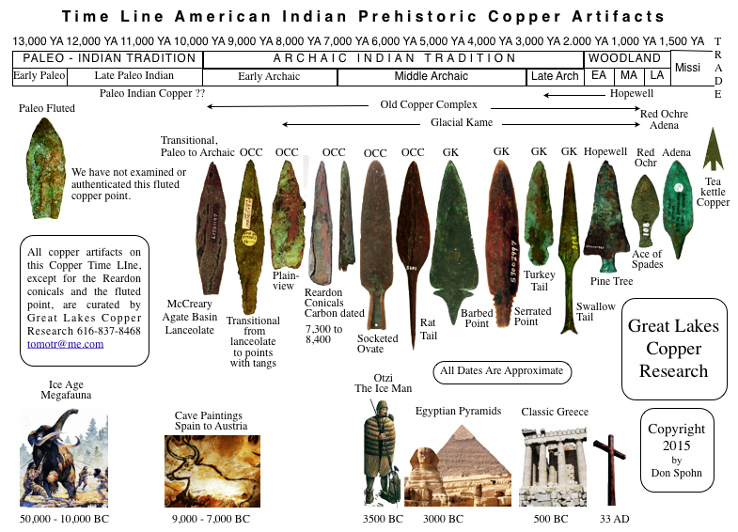

Slide 3
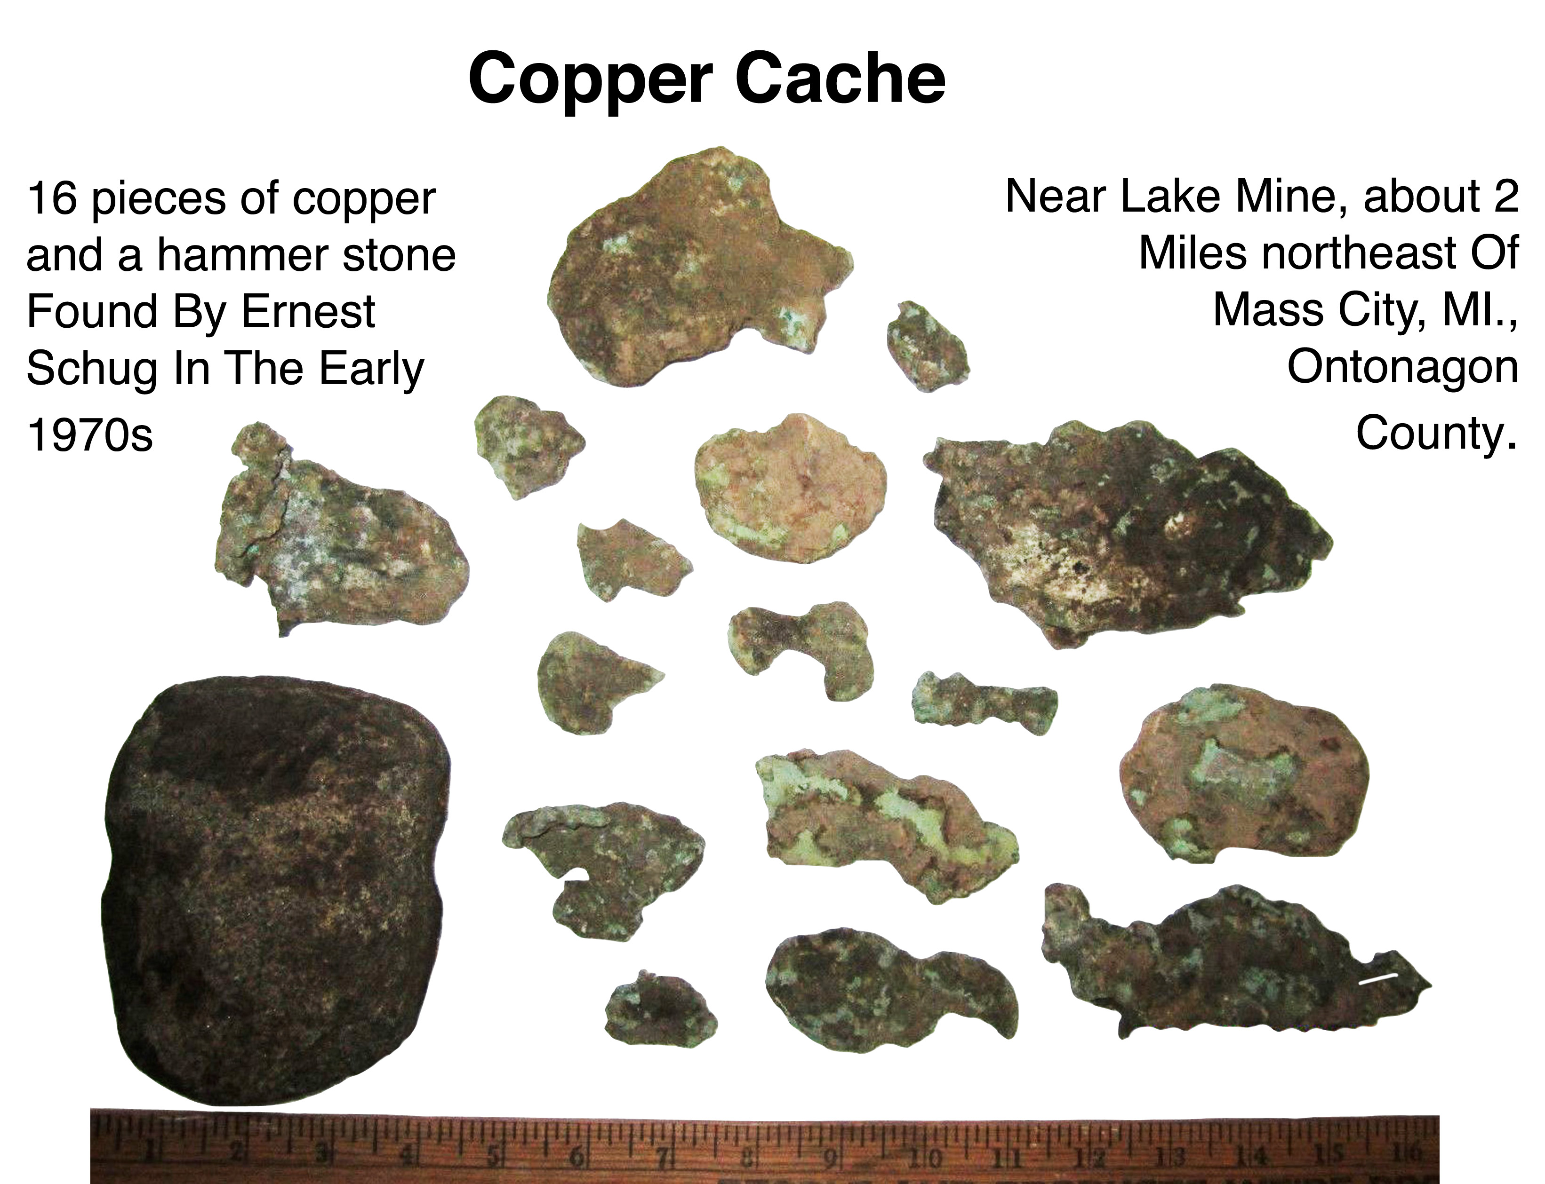
Copper Tool

Slide 4
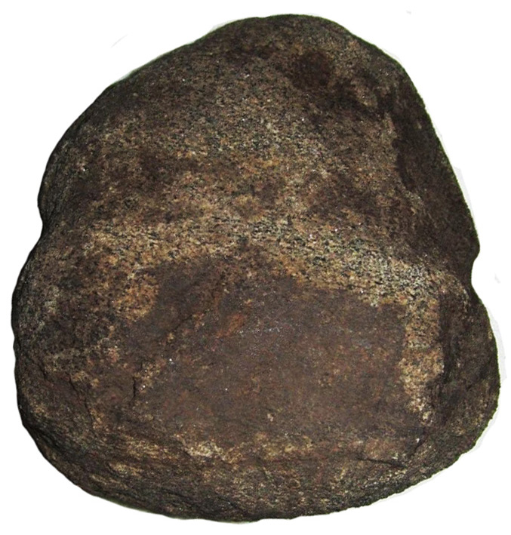
Copper Cache Hammer Stone
Well worn granite hammer stone used by copper
Smiths to
Clean and
Shape Copper
nuggets into implements
& Ornaments
While in constant contact with
copper the
stone
absorbed
copper into
its surface
giving the
hammer
Stone a
copper
color
Width: 4”
Height: 5”
Thickness: 2”
Weight: 2.5 lb

Slide 5
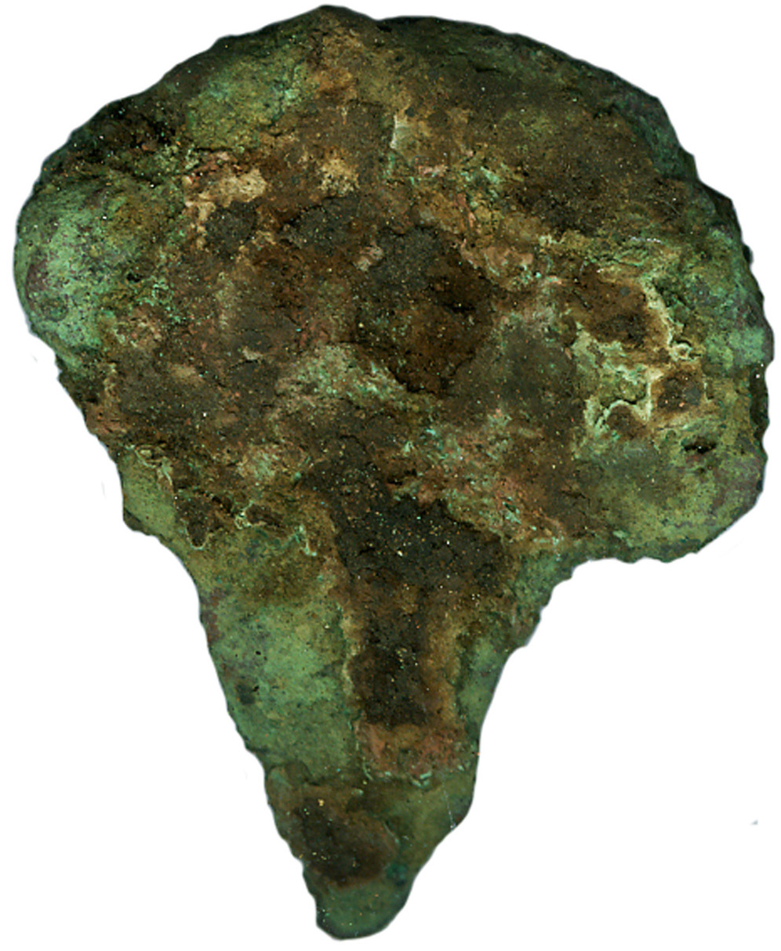
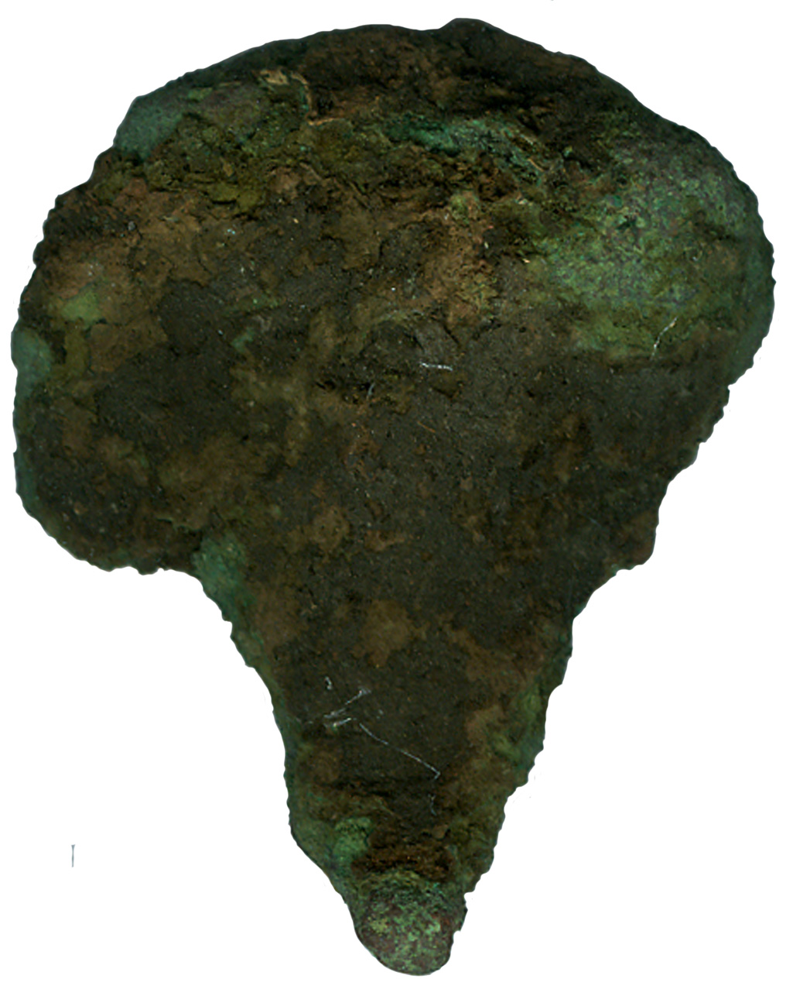
Copper Cache Item
Copper Tool
drill?
graver?
pressure flaker?
Reamer?

Slide 6
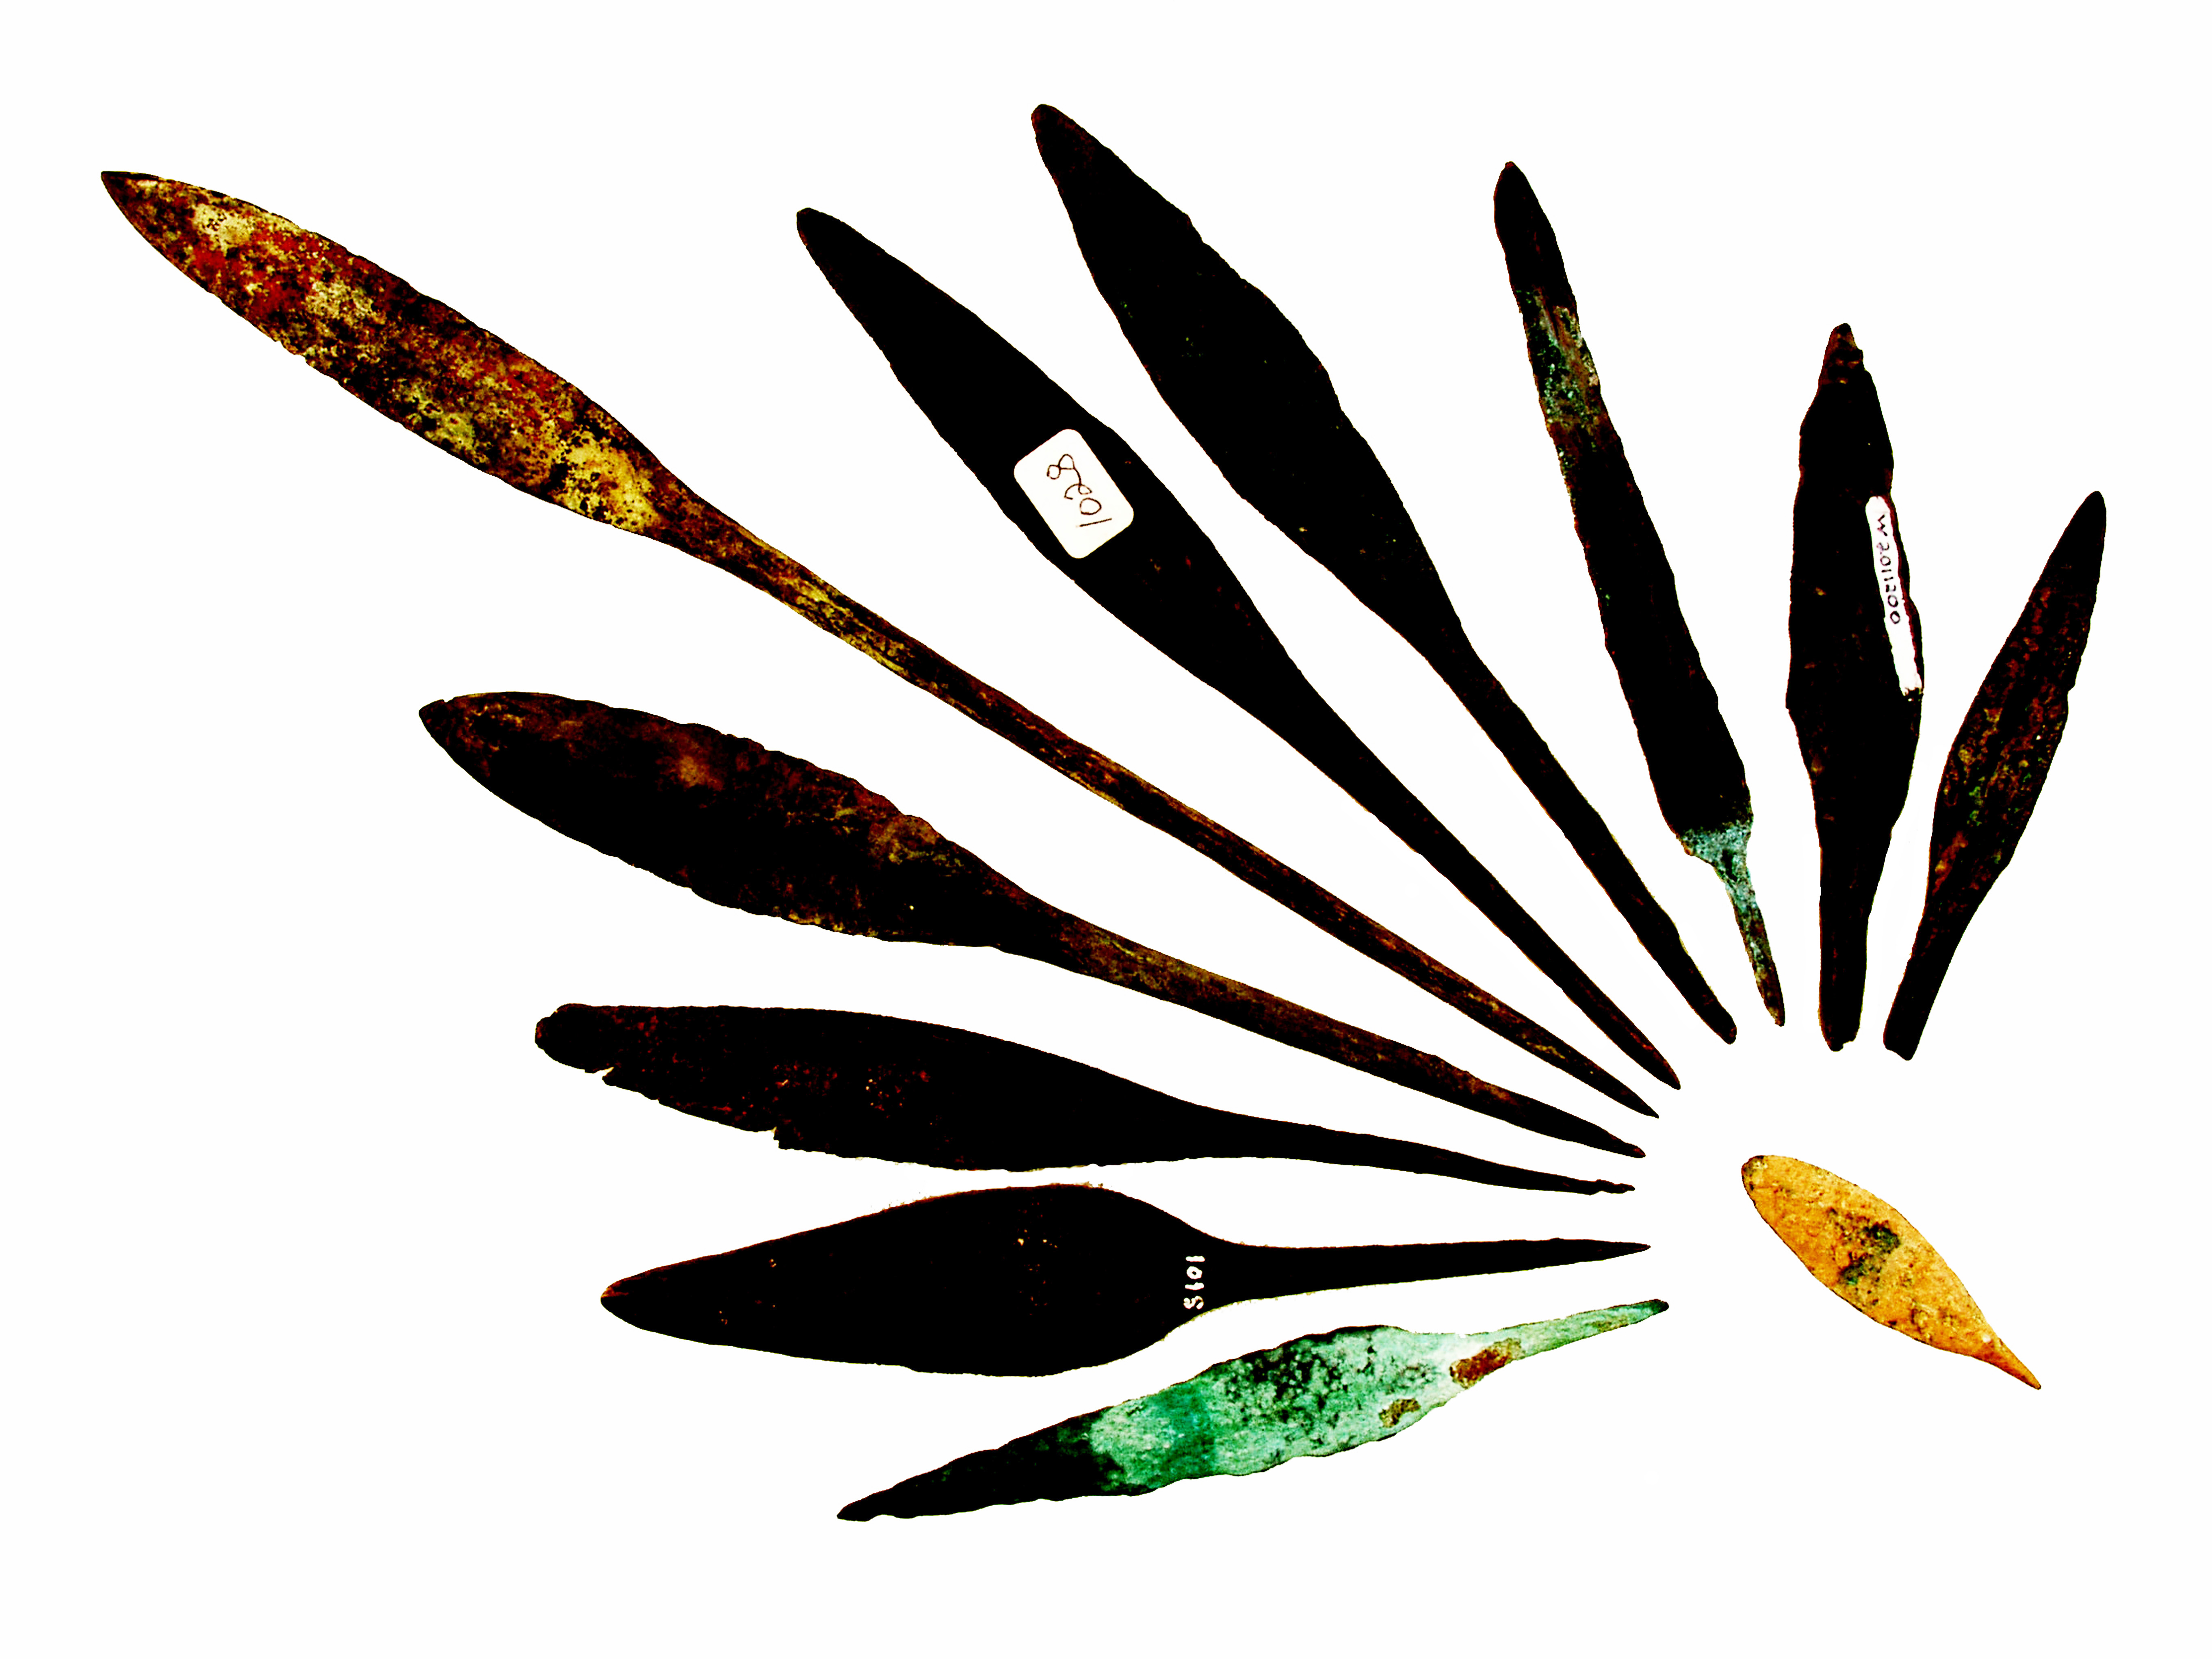
Rat Tail
Spear Points
Longest Point
Is 12 inches

Slide 7
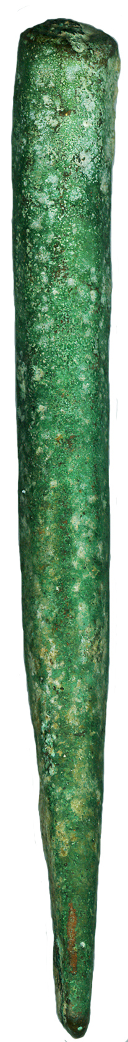

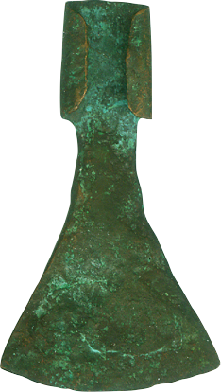
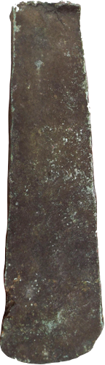
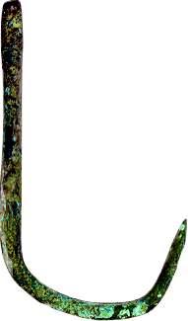
Drill Bit
Chisel
Wedge
Punch
Fish Hook
Needle
Wood Working Adze

Slide 8
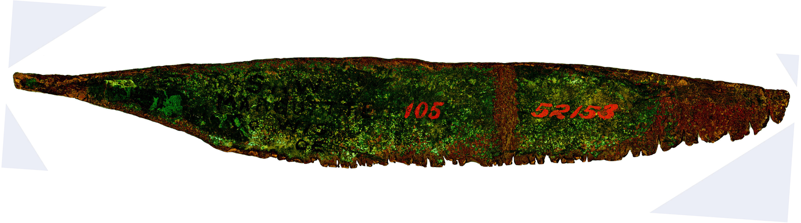
WOOD WORKING HAND SAW
8 Inches Long
Curated by GREAT LAKES COPPER RESEARCH
This old copper tool is pictured in Who’s Who In Indian Relics, No. 7, page 232.
“The teeth on this saw appear to have been cut in place with a stone or copper chisel. They are very sharp and pointed and have been worn down with age and use. The top edge of the blade is squared like a carpenter’s wood saw of today.”
This saw is pictured in John Baldwin’s 1978 Specialized Copper Issue of The Redskins, page 4 and reads in part: “This is probably one of the rarest of copper artifacts.”

Slide 9
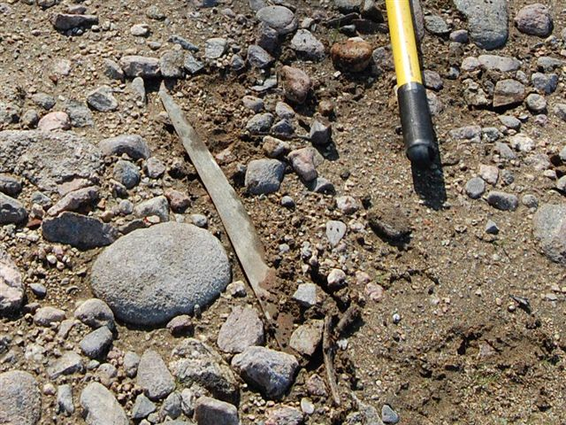
Surface Find
Big Straight Back Knife Found on Dog Lake, Ontario, Canada

Slide 10
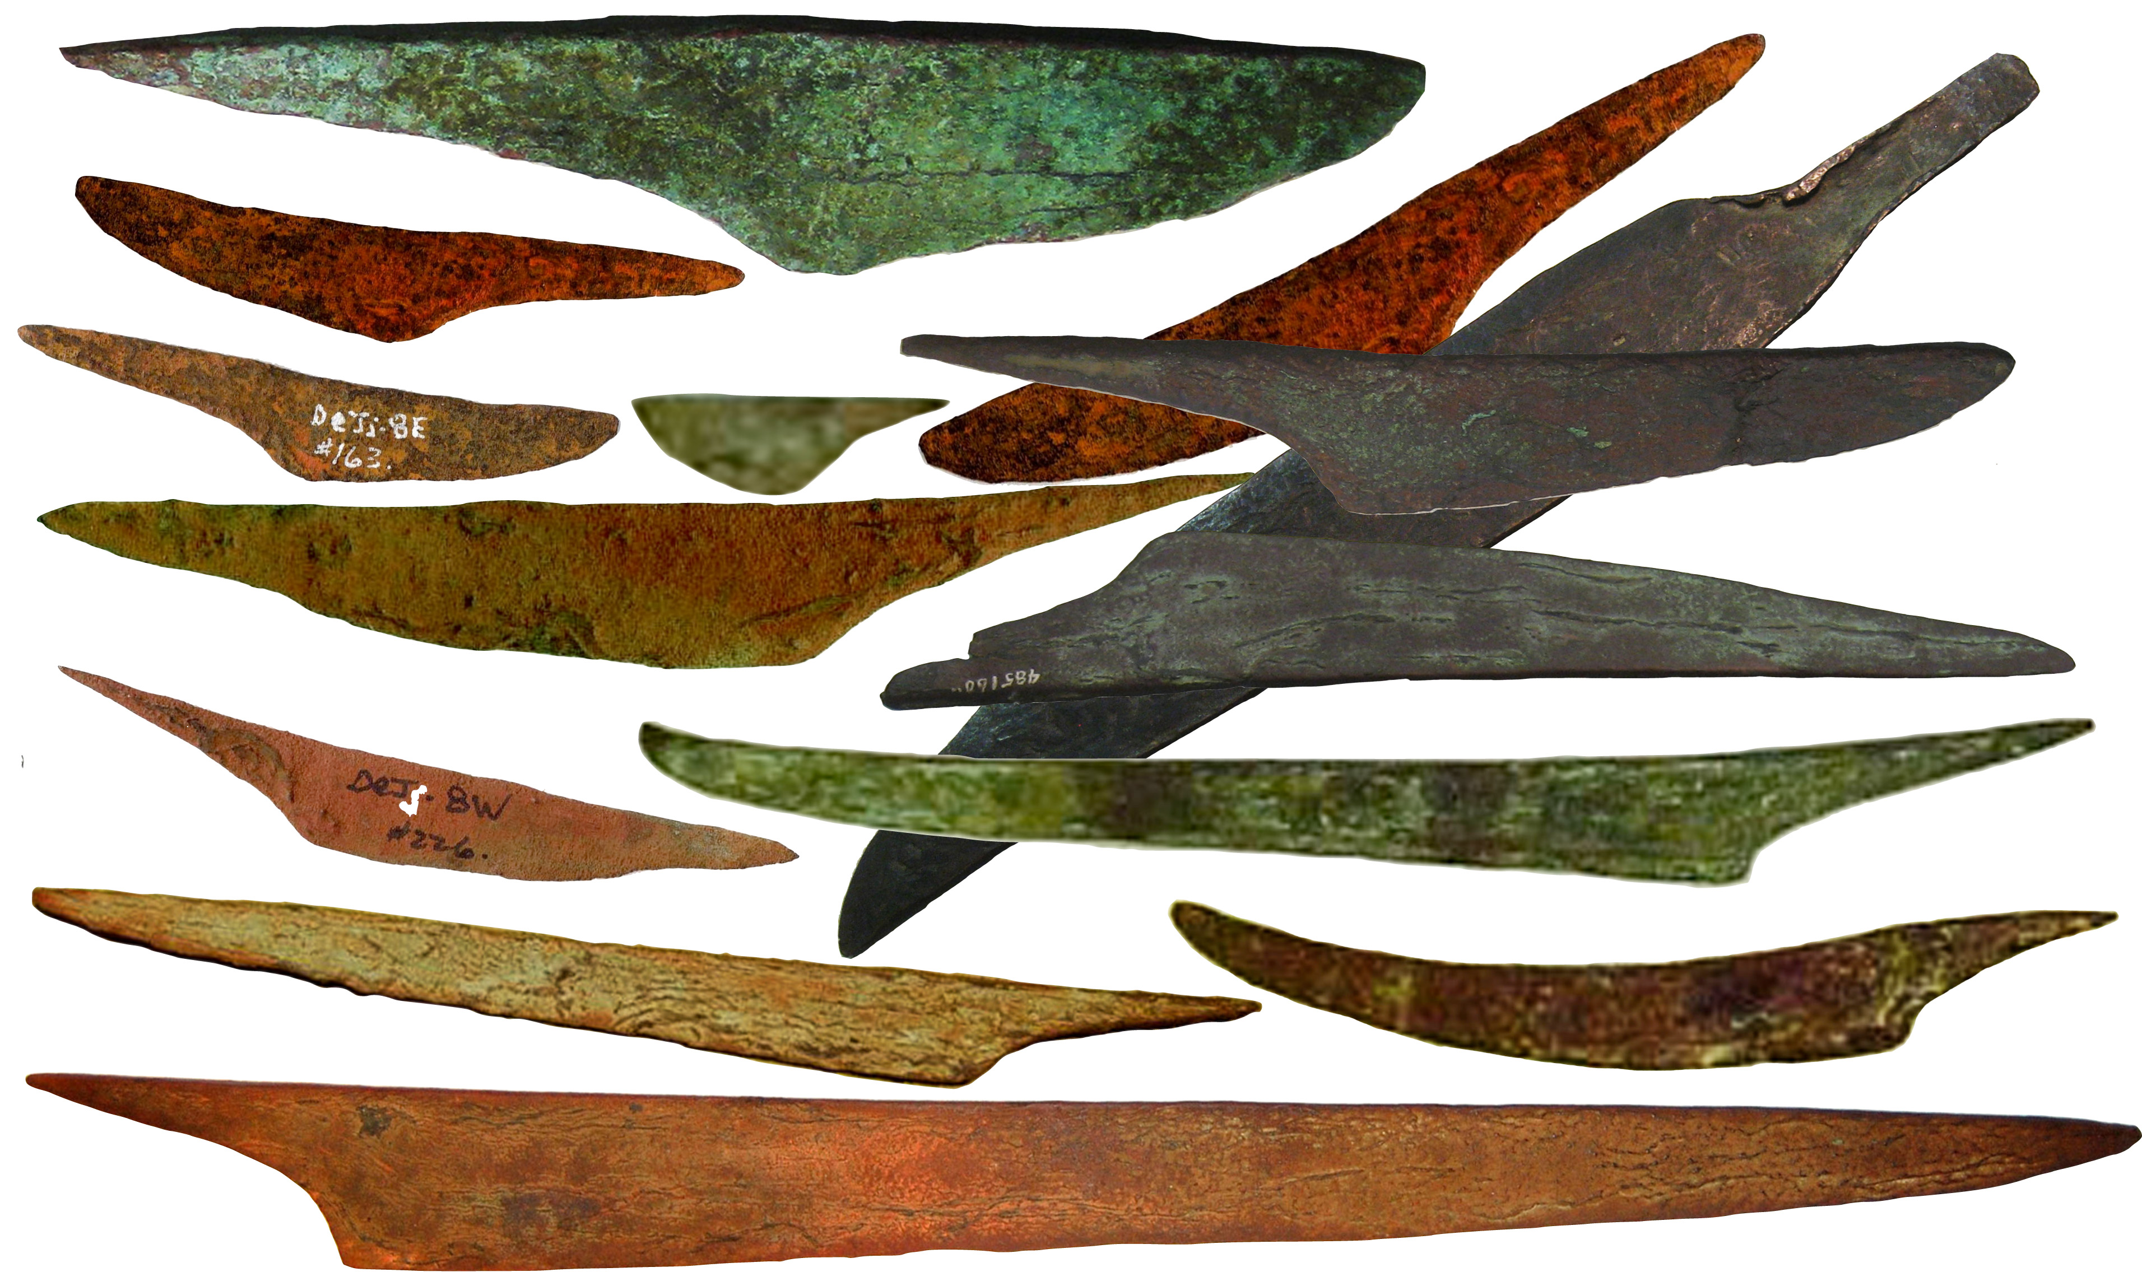
Canadian Straight Back Knife – 21 ½” Long

Slide 11
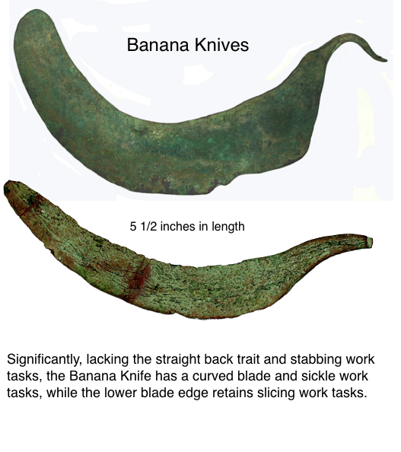

Slide 12
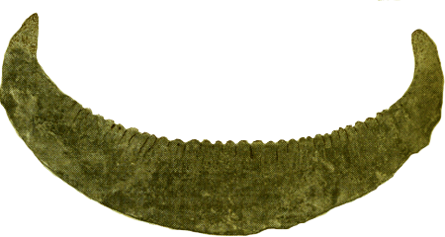
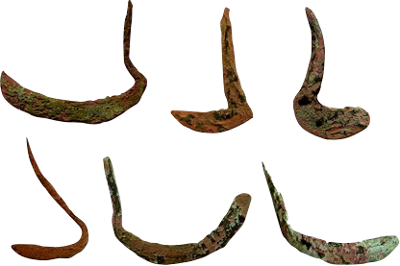
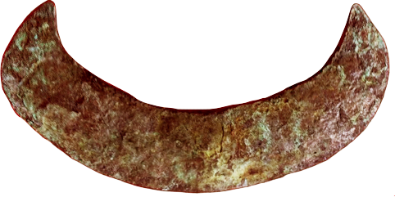
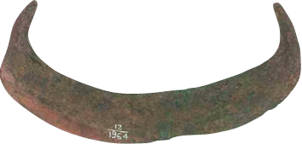
More Sickles Canoe Crescent Knife
Chopper, Rocker Knives

Slide 13
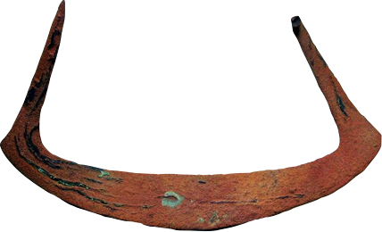
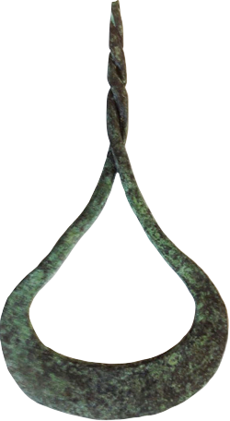
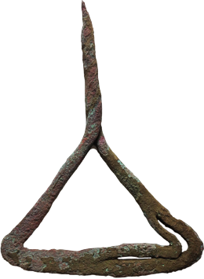
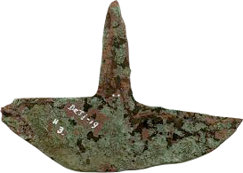
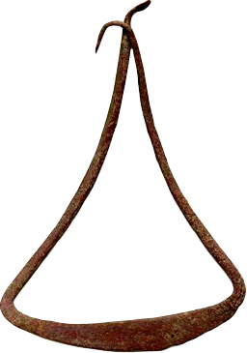
Crescent Knives
Chopper Rocker

Slide 14
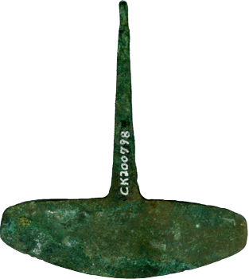
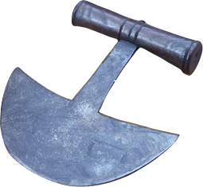
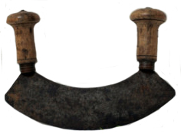
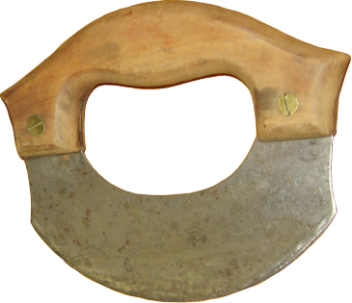
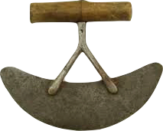
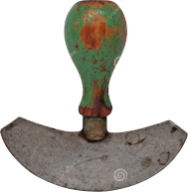
One Prehistoric & Five
Modern Chopper Rockers

Slide 15
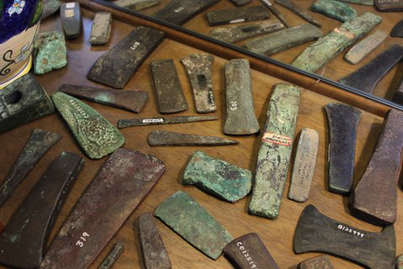
Axes – Great Lakes Copper Research

Slide 16
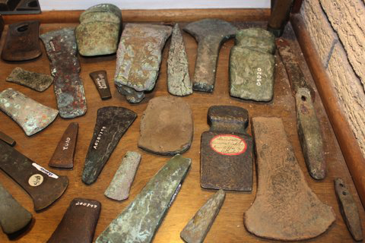
Axes – Great Lakes Copper Research

Slide 17
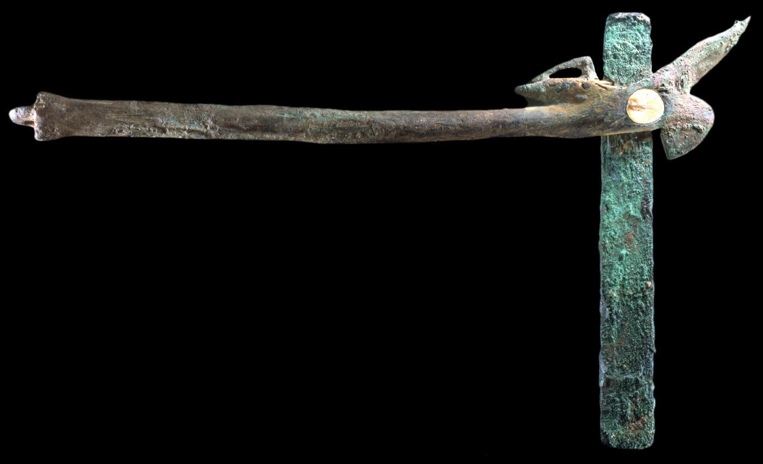
Thousand Year Old Craig Mound Axe
Mounted In The Woodpecker’s Open Beak

Slide 18
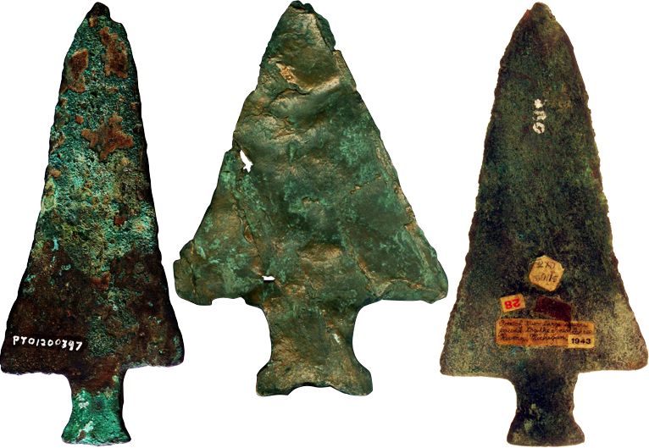
Pine Tree Points – Probable Hopewell
7.5”
13 oz
Great Lake Copper Research Specimens Allegan Co. MI

